Slide 1

From Field to Dashboard:
How We Herd with Data

Slide 2
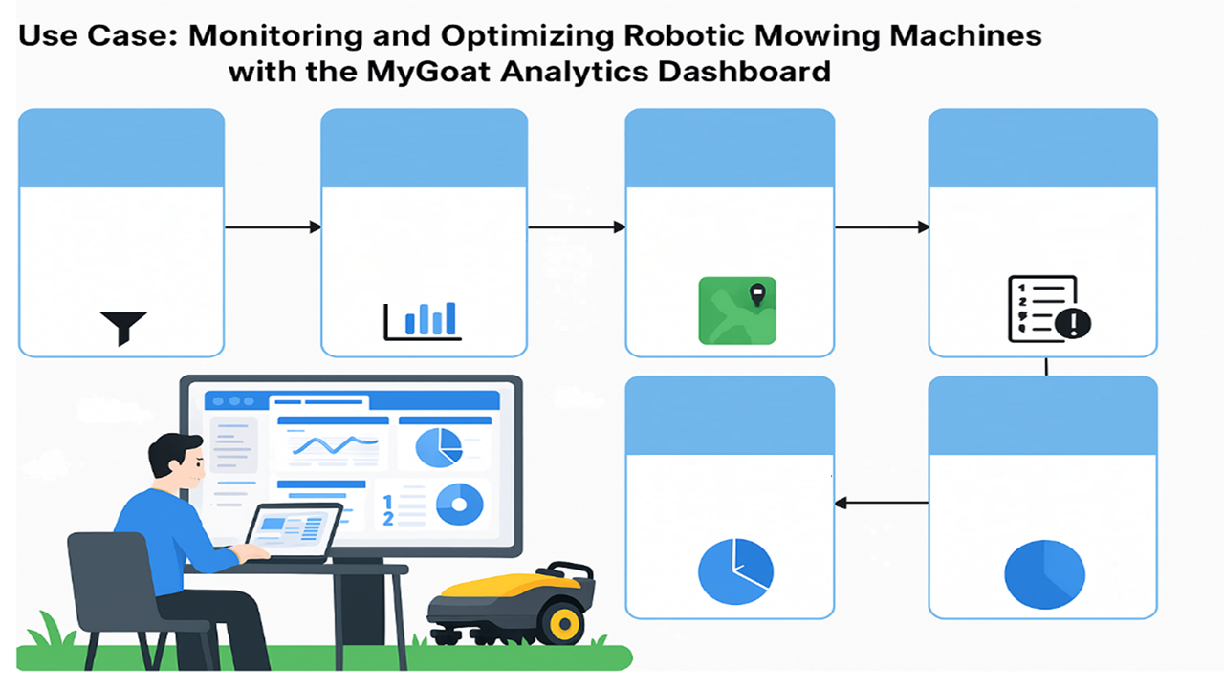
Filter by Customer and Date
Monitor Weekly and Daily Robotic Mowing Machine Activity
Visualize Robotic Mowing Machine Monitoring and Coverage
Track Target vs Actual Performance
Description: Select desired customer (e.g., Hilton Head Airport) and date range.
Description: Review average goat working hours and daily performance charts.
Description: Switch to the heat map to see mowing coverage.
Description:
Review target cuts vs actual cuts and detect any discrepancies in units via the ERROR status.
Investigate Operational Errors
Assess Robotic Mowing Machine Age Distribution
Description: Change status filter to detect units in ERROR state for prompt troubleshooting and resolution.
Description: Use the chart to assess the age distribution of the robotic mowing machines and plan for maintenance or replacements.

Slide 3

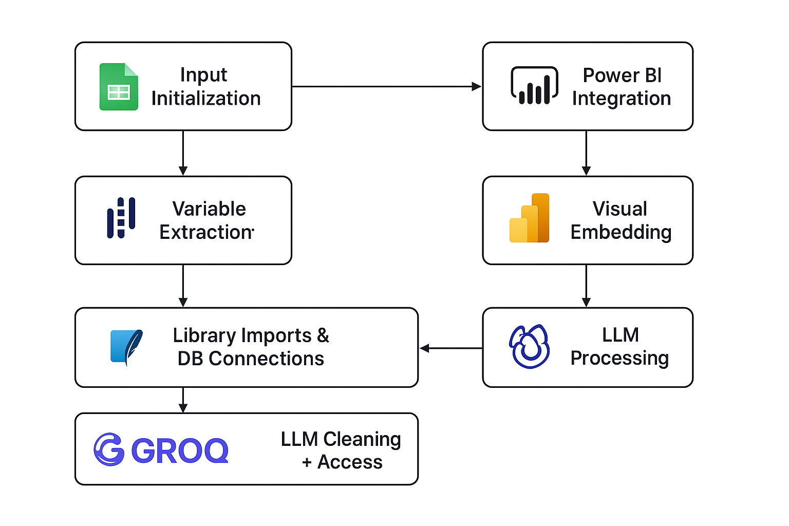

Automated Data Processing and Reporting Pipeline

Slide 4
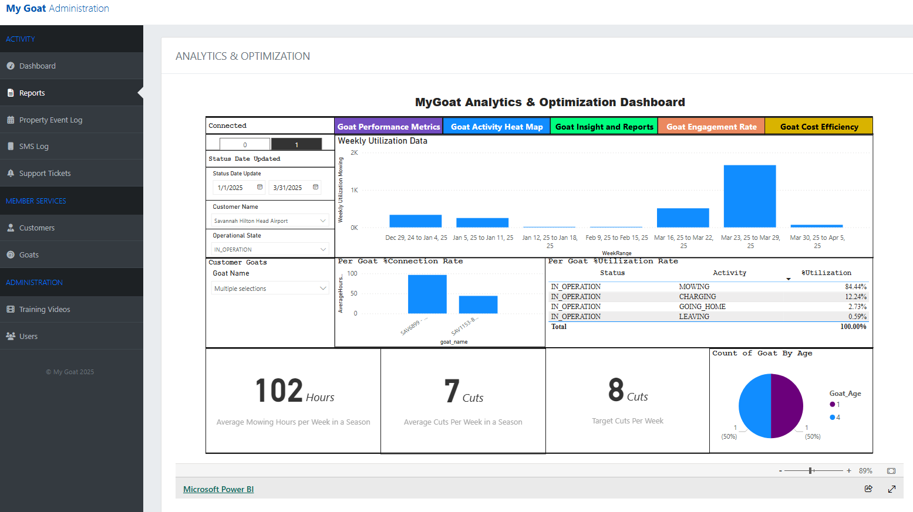
Weekly Performance
Daily Performance
Total Performance
Ticket Data and Error
TCO Calculator
Filter Customer Date and Season
Ave Goat Working Hours on a Weekly Basis
Filter Customer Name
Filter Customers Goat
Click to see the Hours Per Goat
Status Percentage
Ave Goat Working Hours for Season
Actual Cut of the Customer
Target Cut of the Customer
Age of the Goats

Slide 5
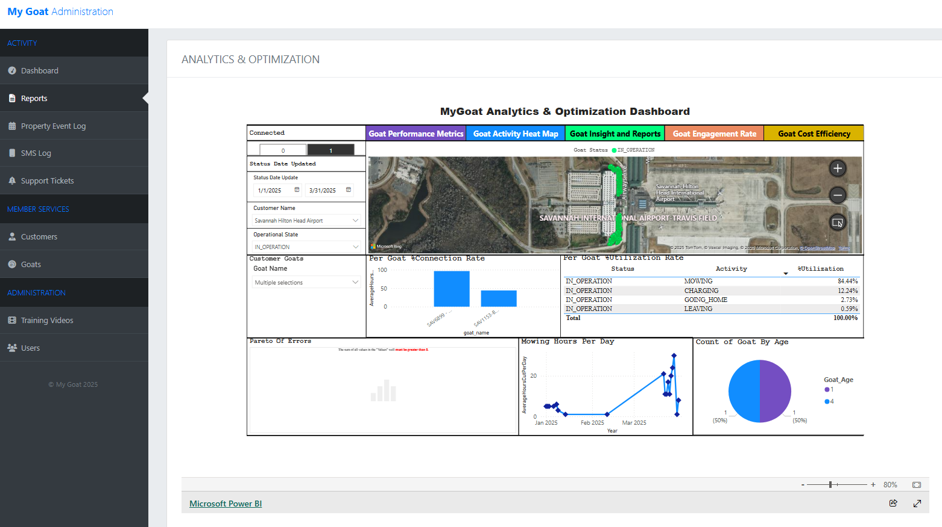
Weekly Performance
Daily Performance
Total Performance
Ticket Data and Error
TCO Calculator
Filter Customer Date and Season
Filter Customer Name
Goat Mowing Coverage
Change Status to see errors in the Map
Filter Customers Goat
Status Percentage
Click to see the Hours Per Goat
Daily Goat Performance
Age of the Goats

